Slide 1
IAmDrone Intelligent Ambulance Drone
Madan Puttaswamy - Drone TX
Mudhassar Ibrahim Sajath - Ambulance TX
Thirukumaran Rajkumar - Drone RX
Ymmen Goel - Ambulance RX

Slide 2
PROBLEM
Ambulances play an important role in the health care department. However, ambulances face the challenge of not being able to deliver medical attention on time.
Primary causes for the delay are usually unexpected road traffic or poor road infrastructure.
One of the most important considerations in emergency treatment is response time.

Slide 3
PROJECT DESCRIPTION
In the event of an emergency, an ambulance with a drone is dispatched to the particular location.
Drones are not affected by factors such as road infrastructure, traffic, etc. and can reach the victim much earlier.
The drone carries with itself a compact defibrillator, medication and CPR. It also has an inbuilt speaker and a video camera, whose feed can be monitored from the ambulance.
A medical personnel in the ambulance can then monitor the condition of the victim and guide a layperson next to the victim while they perform the required first aid until the ambulance arrives.

Slide 4
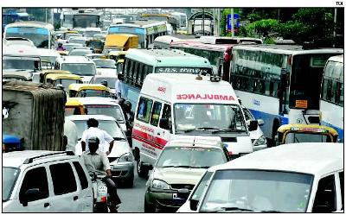
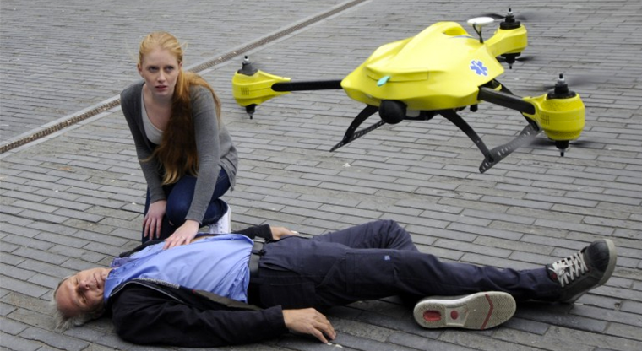
SYSTEM ARCHITECTURE
5.8 GHz Channel
2.4 GHz Channel

Slide 5
TRANSCEIVER MODULE
WAVEFORM
GENERATOR
BPF
POWER AMPLIFIER
LPF
MIXER
ANTENNA
CIRCULATOR
LO
SIGNAL PROCESSING
AMPLIFIER
BPF
BPF
LNA
MIXER

Slide 6
DRONE SPECIFICATIONS
Parameters | Values
Name of the drone | DJI MATRICE 100
Maximum Flight Time (with full load) | 20 mins
Maximum Flight Time(w/o load) | 40 mins
Maximum Range | 5 Km
Maximum payload | 3600 g
Cost | $3300
GPS compatible | Yes
Weight of the drone | 1755 g
Weight of the battery | 676 g
Total weight of the system | 6031 g
Battery Rating | 11,000mAh at 11.1 V

Slide 7
ANTENNA
The location of the victim is fixed but the position of the ambulance changes.
The high gain omni directional antenna is used at the ambulance side to transmit the signal power to long distance.
The antenna at the drone must be small in size and weight in order to lower the payload and it must be omnidirectional to receive signal from all direction.

Slide 8
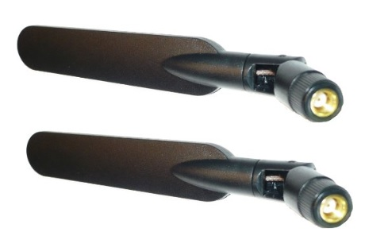

DRONE ANTENNA
PARAMETERS | VALUE
Model | Cisco E2100L
Frequency Range | Dual Band (2.4 &5.8 GHz)
Gain | 6 dBi
Radiation Pattern | Omnidirectional
Price | $8.50

Slide 9
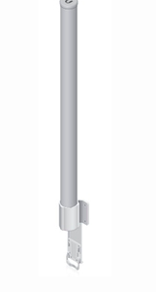

AMBULANCE ANTENNA
PARAMETERS | VALUE
Model | Ubiquiti AMO-2G13
Freq Range | 2.35 - 2.55 GHz
Gain | 13 dBi
Radiation Pattern | Omnidirectional
Cost | $245

Slide 10
2.4 GHz Communication Transmitter

Slide 11
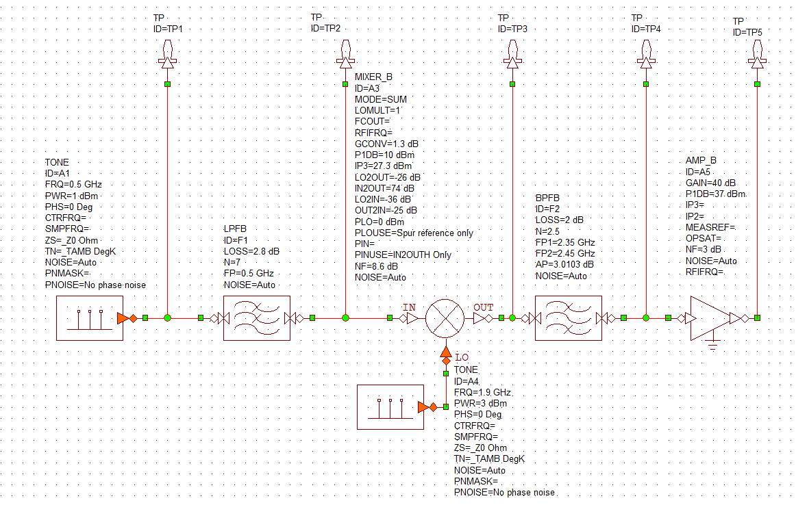
2.4 GHz TRANSMITTER SYSTEM DIAGRAM

Slide 12
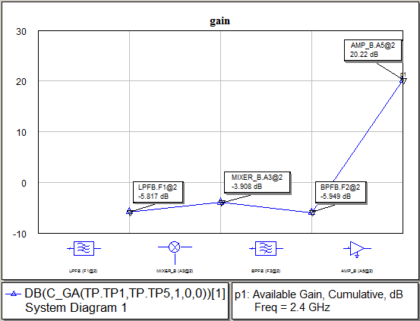
CASCADED GAIN

Slide 13
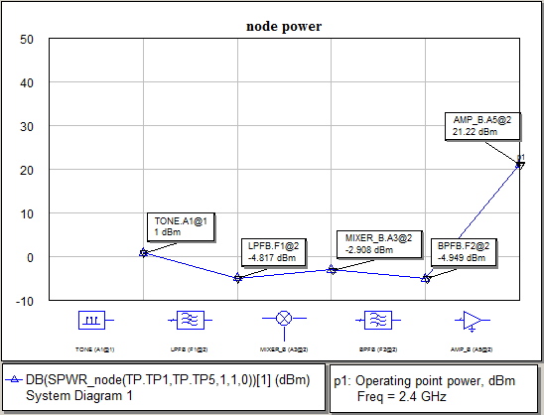
CASCADED NODE POWER

Slide 14
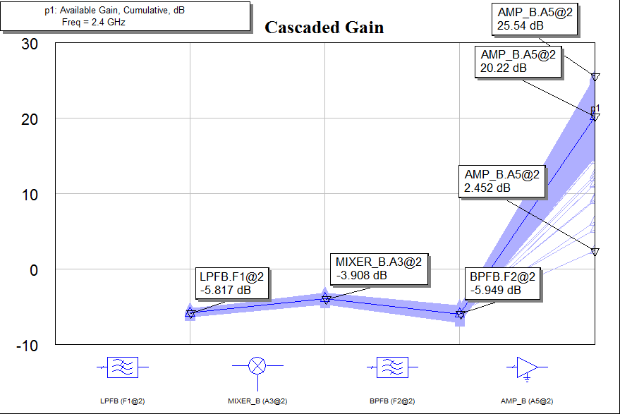
CASCADED GAIN - YIELD ANALYSIS
** Yield Analysis for 1000 iterations. Min. Gain = 2.45dB and Max. Gain = 25.44 dB

Slide 15
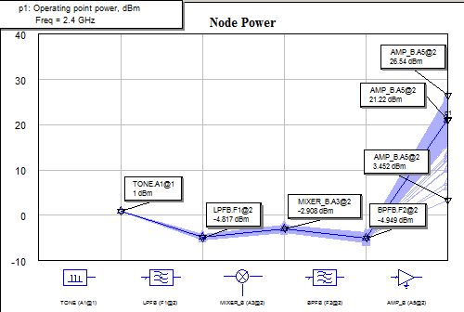
CASCADED NODE POWER – YIELD ANALYSIS
** Yield Analysis for 1000 iterations. Min. Node Power = 3.5dB and Max. Node Power = 26.54dB

Slide 16
Components @ 2.4 GHz

Slide 17

LOCAL OSCILLATOR
PARAMETER | SPECIFICATION
Manufacturer | Linear Technology
Model Number | LTC6945
Power | -6 to +3 dBm
Frequency Range | 0.35GHz to 6 GHz

Slide 18

LOW PASS FILTER
PARAMETER | SPECIFICATION
Manufacturer | Crystek Corporation
Model number | CLPFL-0500
Insertion Loss | 2.8 dB(Nominal)
Frequency Range | DC to 500 MHz

Slide 19
MIXER
PARAMETER | SPECIFICATION
Manufacturer | Linear Technology
Model Number | LT5579
Conversion Gain | 1.3 dB
P1dB(output) | 10 dBm
Output 3rd Order Intercept | 27.3 dBm
Frequency Range | 1.5 – 3.8 GHz

Slide 20


BAND PASS FILTER
PARAMETER | SPECIFICATION
Manufacturer | Johanson Technology, Inc.
Model Number | 1810BP07B200T
Insertion Loss | 2 dB(Nominal)
Frequency Range | 1.4 – 2.6 GHz

Slide 21

POWER AMPLIFIER
PARAMETER | VALUE
Model | SKY65006-348LF
Frequency | 1.5-3.5 GHz
Low Voltage Positive Bias supply | 3.3V
Low quiescent current | 50mA
Small Signal Gain | 40 dB
P1dB point | 37 dBm

Slide 22
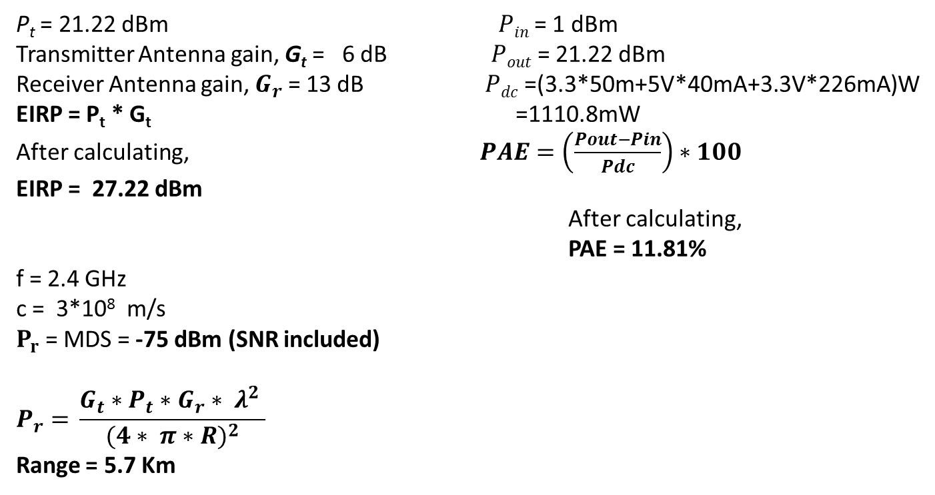
P_{t} = 21.22 dBm $Pin$= 1 dBm
Transmitter Antenna gain, G_{t} = 6 dB $Pout$= 21.22 dBm
Receiver Antenna gain, $G_{r}$ = 13 dB $Pdc$=(3.3*50m+5V*40mA+3.3V*226mA)W
EIRP = P_{t} * G_{t} =1110.8mW
After calculating, $PAE=\left(\frac{Pout−Pin}{Pdc}\right)∗100$
EIRP = 27.22 dBm
After calculating,
PAE = 11.81%
f = 2.4 GHz
c = 3*10⁸ m/s
$P_{r}$ = MDS = -75 dBm (SNR included)
$$P_{r}{= }\frac{G_{t}∗P_{t}∗G_{r}∗ λ^{2} }{{(4∗ π∗R)}^{2}}$$
Range = 5.7 Km

Slide 23
5.8 GHz Communication Receiver

Slide 24
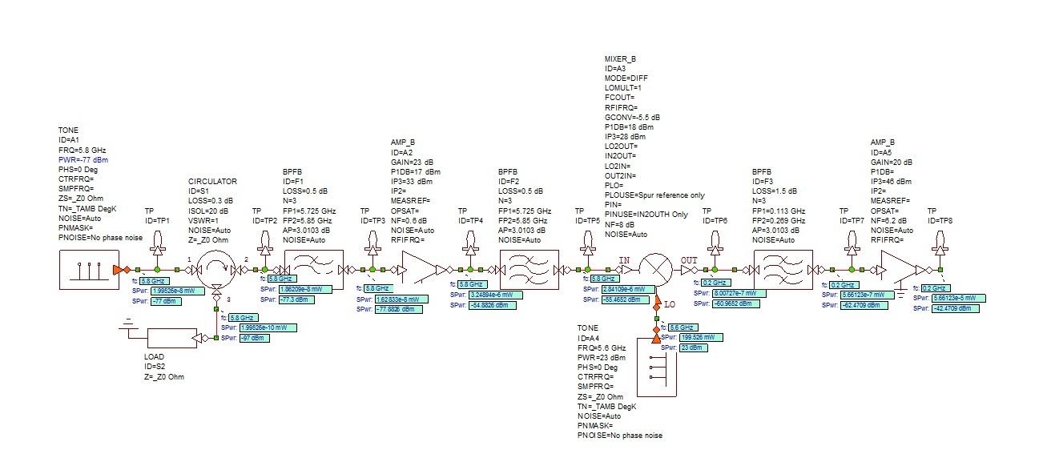
5.8 GHz RECEIVER SYSTEM DIAGRAM

Slide 25
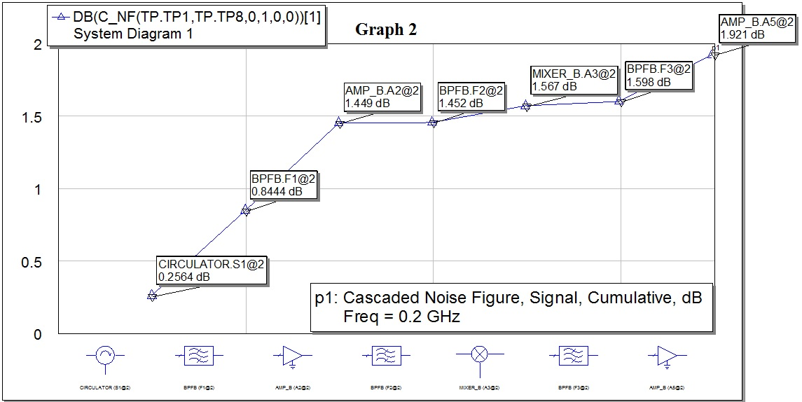
CASCADED NOISE FIGURE
The RX maintains a low NF of 1.921 dB.

Slide 26
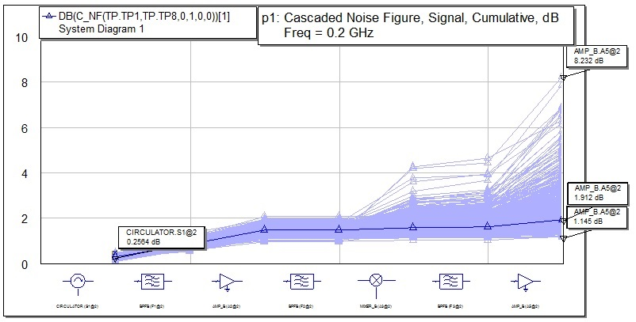
CASCADED NF – YIELD ANALYSIS
Cascaded NF varies from 1.145 dB to 8.232 dB.

Slide 27
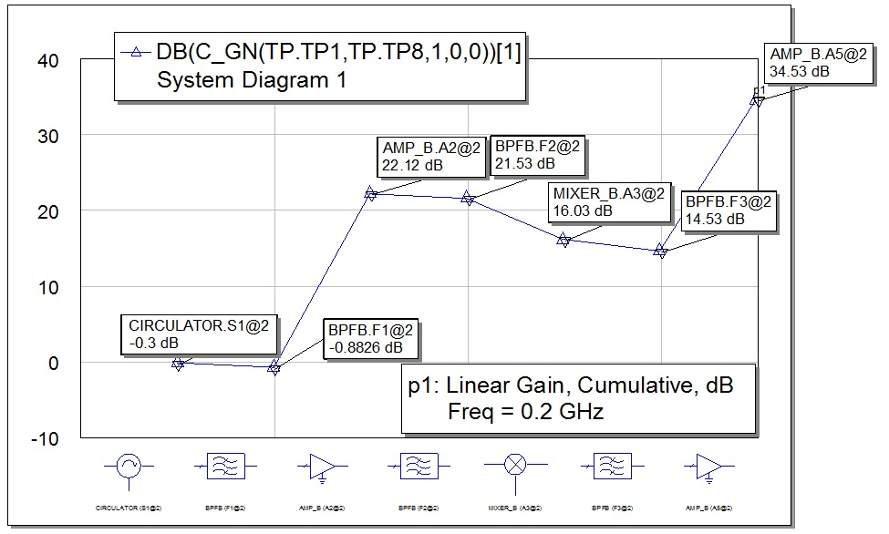
CASCADED GAIN
The Rx needs has a gain of 34.53 dB.

Slide 28
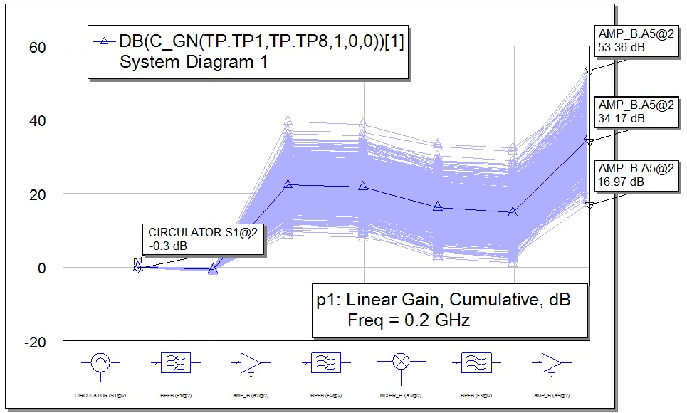
CASCADED GAIN – YIELD ANALYSIS
Cascaded Gain stays within the limit of 16.97dB to 53.36dB.

Slide 29
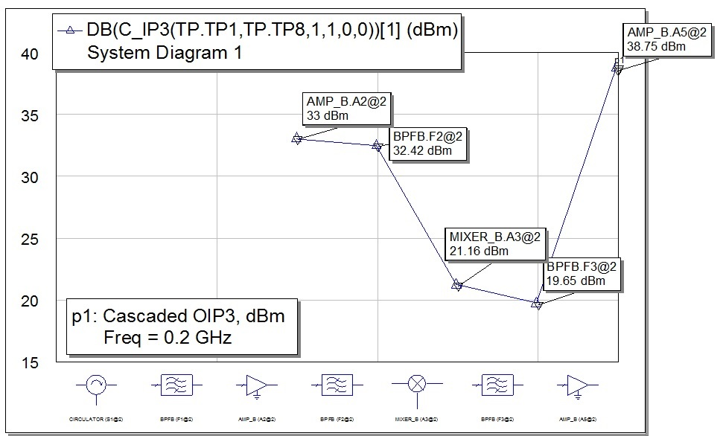
CASCADED IP3
The cascaded IP3 of the Drone Receiver is 38.75 dBm.

Slide 30
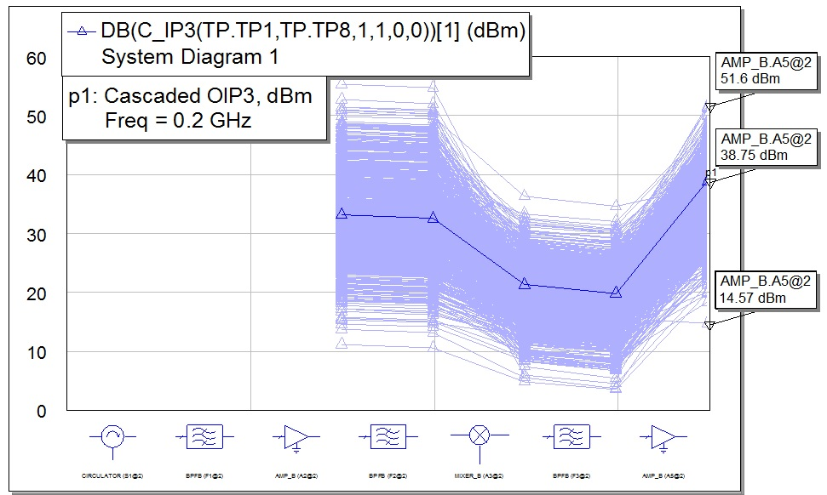
CASCADED IP3 – YIELD ANALYSIS
The cascaded IP3 has large variation from 14.57dBm to 51.6dBm.

Slide 31
Components @ 5.8 GHz

Slide 32

CIRCULATOR
PARAMETERS | VALUE
Model | 3C40C-8
Isolation | 20 dB
Insertion Loss | 0.3 dB

Slide 33

BANDPASS FILTER
PARAMETERS | VALUE
Insertion Loss | 0.5 dB
Noise Figure | 0.5 dB
BW | 125 Mhz
Frequency | 5.8 GHz

Slide 34
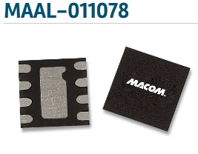
LNA
PARAMETERS | VALUE
Model no. | MAAL-011078
Gain | 23 dB
Noise Figure | 0.6 dB
P1dB | 17 dBm
OIP3 | 33 dBm
Vdc | 5 V
Idc | 50 mA
Freq Range | 700 – 6000 GHz

Slide 35

MIXER WITH LO
PARAMETER | VALUE
Model no. | MR128
Loss | 5.5 dB
NF | 8 dB
Freq range | 4 – 18 (GHz)
Drive Level | 23 dBm
P1dB | 18dBm
IIP3 | 28 dBm
LO power(max) | 353 mW
DC Operation | 4.2V, 84mA

Slide 36

LOW PASS FILTER
PARAMETERS | VALUE
Model | B73220M1
Insertion Loss | < 1.5 dB
Frequency Range | 113 - 269 MHz

Slide 37

IF AMPLIFIER
PARAMETERS | VALUE
Model | LTC6420
Gain | 20 dB
Frequency Range | LF - 850 MHz
NF | 6.2 dB
OIP3 | 46 dBm
Pdc | 240 mW

Slide 38
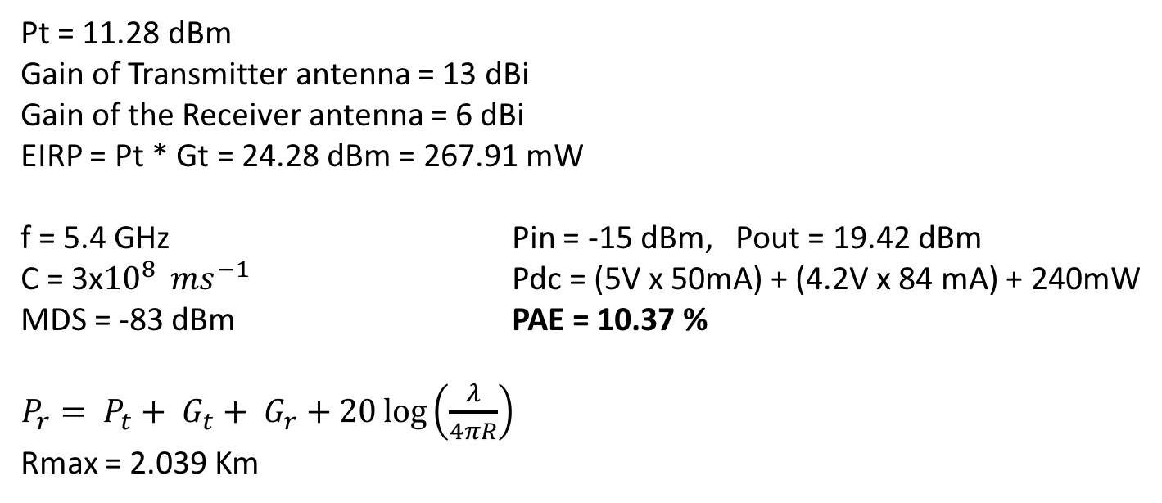
HAND CALCULATIONS
Pt = 11.28 dBm
Gain of Transmitter antenna = 13 dBi
Gain of the Receiver antenna = 6 dBi
EIRP = Pt * Gt = 24.28 dBm = 267.91 mW
f = 5.4 GHz Pin = -15 dBm, Pout = 19.42 dBm
C = 3x${10}^{8 } ms^{−1}$ Pdc = (5V x 50mA) + (4.2V x 84 mA) + 240mW
MDS = -83 dBm PAE = 10.37 %
$P_{r}= P_{t}+ G_{t}+ G_{r}+20\log\left(\frac{λ}{4πR}\right)$
Rmax = 2.039 Km

Slide 39
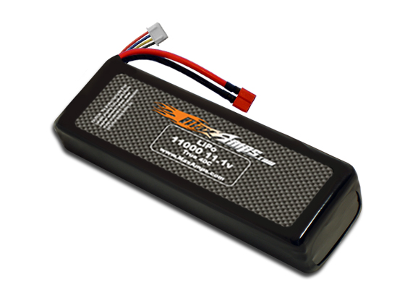
BATTERY
Lithium Polymer Battery
Specs: 11,000 mAh, 11.1 V
Price: $249.99
*Various voltage regulators and convertors will be used according to component requirements.

Slide 40
COMPLIANCE MATRIX FOR 2.4GHz CHANNEL
PROPERTIES | SPECIFICATION | PROJECTED PERFORMANCE | COMPLIANT
Operating Frequency (GHz) | 2.4GHz-2.5GHz (Centre frequency 2.4 GHz) | 2.4GHz-2.45GHz (Centre frequency 2.4 GHz) | Yes
Transmitted Power | 20 dBm | 21.22 dBm | Yes
Noise Figure (RX) | 12 dB | 3.495 dB | Yes
Maximum Range | 5 km | 5.7 Km | Yes
Minimum Detectable Signal | -80 dBm | -75 dBm | Yes
Maximum Antenna Gain(dBi) | 12 dBi | 13 dBi | Yes
DC Power (Ambulance) | 10W | 4.5W | Yes
PROP

Slide 41
COMPLIANCE MATRIX FOR 5.8GHz CHANNEL
PROPERTIES | SPECIFICATION | PROJECTED PERFORMANCE | COMPLIANT
Operating Frequency (GHz) | 5.725 – 5.85 GHz fc = 5.8 GHz | 5.725 – 5.85 GHz fc = 5.8 GHz | YES
Transmitted Power ( max allowed ) | 24 dBm | 24.28 dBm | ALLOWABLE
Noise Figure (RX) | 12 dB | 1.912 dB | YES
Maximum Range | 5 Km | 2.039 Km | NO
Minimum Detectable Signal | -87 dBm | -83 dBm | YES
Maximum Antenna Gain (Rx dBi) | 7 dBi | 6 dBi | ALLOWABLE
Expected DC power (TX and Rx Drone) | 2 W | 1.94W | YES

Slide 42
FINANCIAL ANALYSIS
COMPONENT | COST (Approx.)
Drone | $3300
Ambulance Transceiver | $360 + $320
Drone Transceiver | $550 + $2100
Miscellaneous (signal processor and on-Board Radar) | $1500
Total | $8130
The total cost of the product is acceptable if its application in the ambulance taken into consideration.

Slide 43
MILESTONES
Activity/Time Period | Sep | Oct | Nov | Dec | Jan | Feb | March
Analyzing the issues of design
System level design
Software implementation
Testing and debugging
Fabrication of the system and implementation
Transceiver module testing
Final implementation with the drone

Slide 44
PERFORMANCE / PROPAGATION ISSUES
The Drone covers only 2 Km against 5 Km due to limitation of low mAH Battery and high payload.
Desired signal must be strong enough to be not affected by blocker frequencies.
Transceiver’s placement at drone had to be adjusted so that it does not affect its flight.
The Sensitivity of the receiver must be strong enough to detect the appropriate signal from the unwanted signals.

Slide 45
MANUFACTURING AND TEST ISSUES
As failure of the system can cost a life, Kaizen and six sigma process is employed to ensure not more than (3.4 defects per million).
A real life scenario with many ISM band devices is simulated to test the performance of Transceiver.
The Drone is attached to Defibrillator which increases its payload.

Slide 46
HEALTH & ENVIRONMENT ISSUES
Health Issues :
The Maximum Permissible Exposure level set by IEEE is 2mW @ 2.4GHz and 4mW @ 5.8 GHz. The power transmitted in the form of radiation in the system is lower than the MPE.
Environmental Issues :
Components chosen for the system are compliant to RoHS (Restriction of Hazardous Substances) to save environment.

Slide 47
CONSUMER ISSUES
There is a possibility, albeit very low of the drones colliding with people or other objects.
The drones will be registered with the Federal Aviation Administration of the United States.

Slide 48
Thank You

Slide 49
APPENDIX

Slide 50
2.4 GHz RECEIVER SYSTEM DIAGRAM

Slide 51
CASCADED NOISE FIGURE
The RX maintains a low NF of 3.5dB.

Slide 52
CASCADED NOISE FIGURE - YIELD ANALYSIS
Cascaded NF does not vary much. Range is 2.8 dB to 4.8 dB.

Slide 53
CASCADED GAIN
The Rx needs a high gain of 54 dB.

Slide 54
CASCADED GAIN - YIELD ANALYSIS
Cascaded Gain stays within the limit of 45dB to 56dB.

Slide 55
CASCADED IP3 - YIELD ANALYSIS
The cascaded IP3 has large variation from 10dBm to 37 dBm.

Slide 56

CIRCULATOR
PARAMETERS | VALUE
Model | SX-10WR
Isolation | 20 dB
Insertion Loss | 0.5 dB

Slide 57
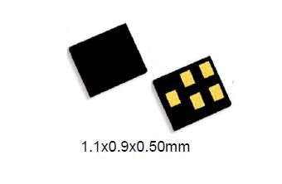

BANDPASS FILTER
PARAMETERS | VALUE
Insertion Loss | 1 dB
Noise Figure | 1 dB
BW | 100 Mhz
Frequency | 2.4 GHz

Slide 58

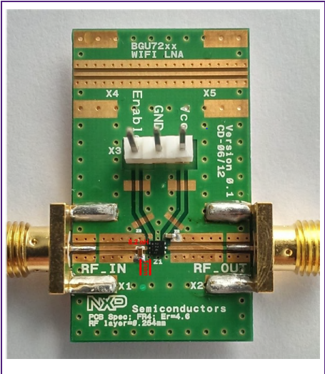
LNA
PARAMETERS | VALUE
Model no. | BGU7224
Gain | 25
Noise Figure | 1.5 dB
P1dB | 22 dBm
OIP3 | 32 dBm
Vdc | 10V V
Idc | 110mA
Freq Range | 2.4 – 2.5 GHz

Slide 59
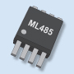
MIXER WITH LO
PARAMETER | VALUE
Model no. | ML485
Loss | 8.5 dB
NF | 11 dB
Freq range | 1.5-3.2 (GHz)
Drive Level | 0 dBm
P1dB | 11dBm
IIP3 | 37 dBm
LO power(max) | 10dBm
DC Operation | 7V,40mA

Slide 60

LOW PASS FILTER
PARAMETERS | VALUE
Model | BLP-150
Insertion Loss | 1 dB
Frequency Range | 150 MHz

Slide 61
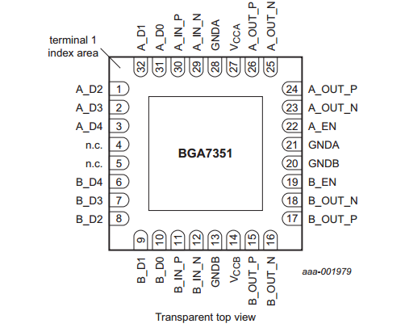
IF AMPLIFIER
PARAMETERS | VALUE
Model | BGA7351
Gain | 22 dB
Frequency Range | 50-500 MHz
P1dB | 16.5 dBm
OIP3 | 46 dBm
Vdc,Idc | 5 V, 3 mA

Slide 62
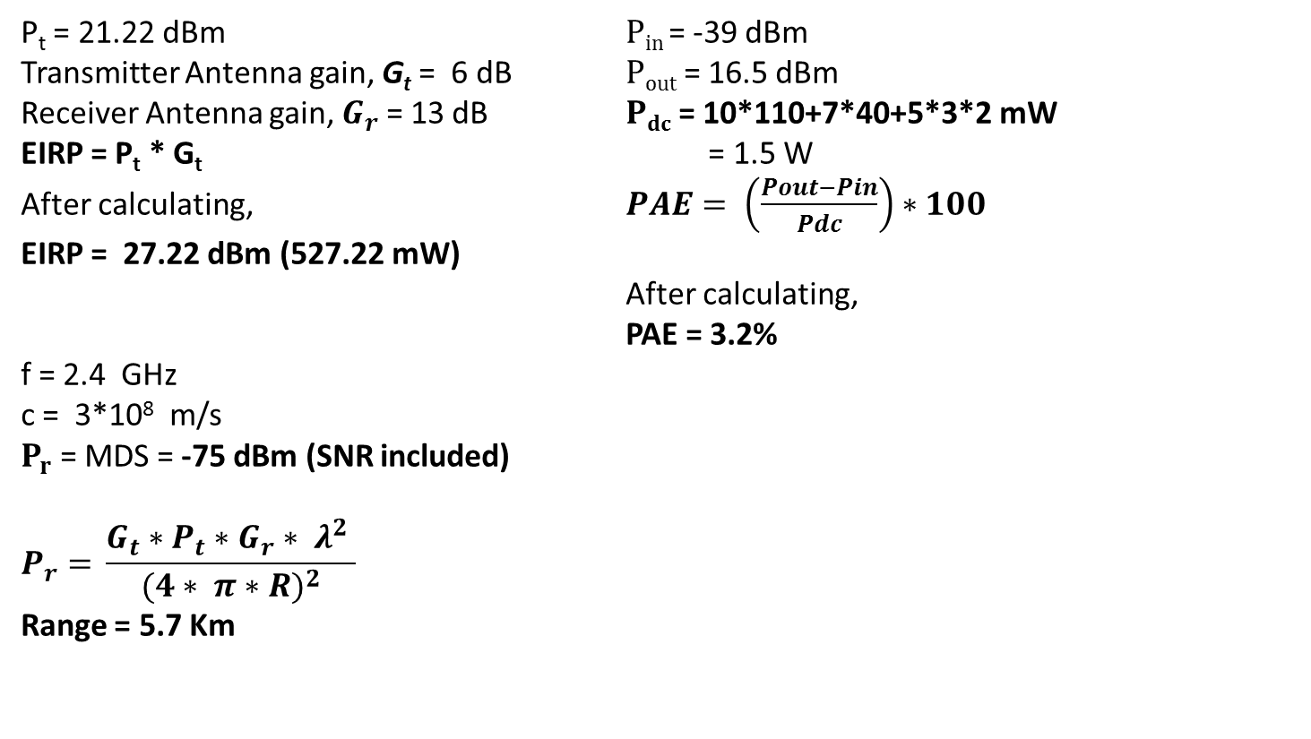
HAND CALCULATIONS
P_{t} = 21.22 dBm $Pin$= -39 dBm
Transmitter Antenna gain, G_{t} = 6 dB $Pout$= 16.5 dBm
Receiver Antenna gain, $G_{r}$ = 13 dB $Pdc$= 10*110+7*40+5*3*2 mW
EIRP = P_{t} * G_{t} = 1.5 W
After calculating, $PAE= \left(\frac{Pout−Pin}{Pdc}\right)∗100$
EIRP = 27.22 dBm (527.22 mW)
After calculating,
PAE = 3.2%
f = 2.4 GHz
c = 3*10⁸ m/s
$P_{r}$ = MDS = -75 dBm (SNR included)
$$P_{r}{= }\frac{G_{t}∗P_{t}∗G_{r}∗ λ^{2} }{{(4∗ π∗R)}^{2}}$$
Range = 5.7 Km

Slide 63
COMPLIANCE MATRIC FOR 2.4GHz CHANNEL
PROPERTIES | SPECIFICATION | PROJECTED PERFORMANCE | COMPLIANT
Operating Frequency (GHz) | 2.4GHz-2.45GHz (Centre frequency 2.4 GHz) | 2.35GHz-2.45GHz (Centre frequency 2.4 GHz) | Yes
Transmitted Power | 20 dBm | 21.22 dBm | Yes
Noise Figure (RX) | 12 dB | 3.495 dB | Yes
Maximum Range | 5 km | 5.7 Km | Yes
Minimum Detectable Signal | -80 dBm | -75 dBm | Yes
Maximum Antenna Gain(dBi) | 12 dBi | 13 dBi | Yes
PROP

Slide 64
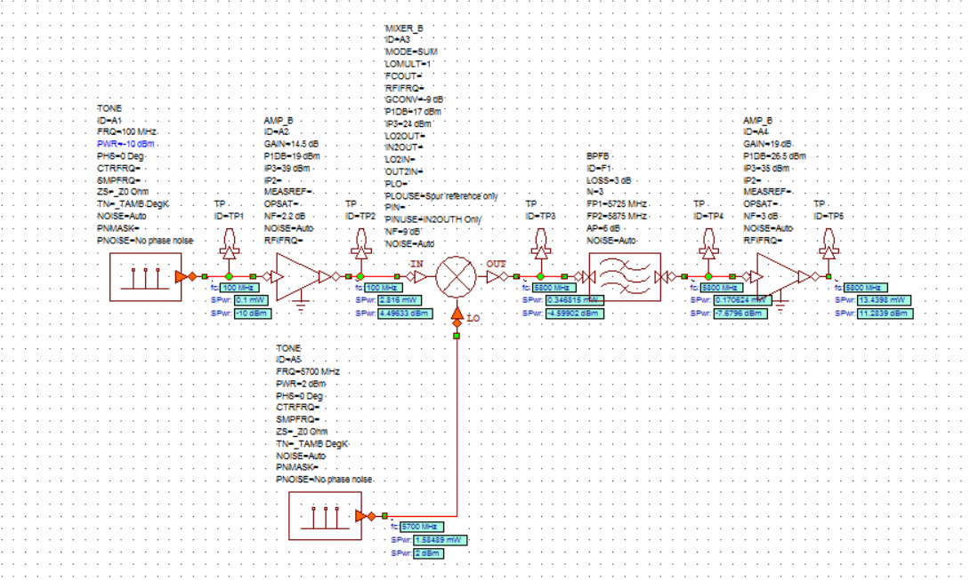
5.8 GHz TRANSMITTER SYSTEM DIAGRAM

Slide 65
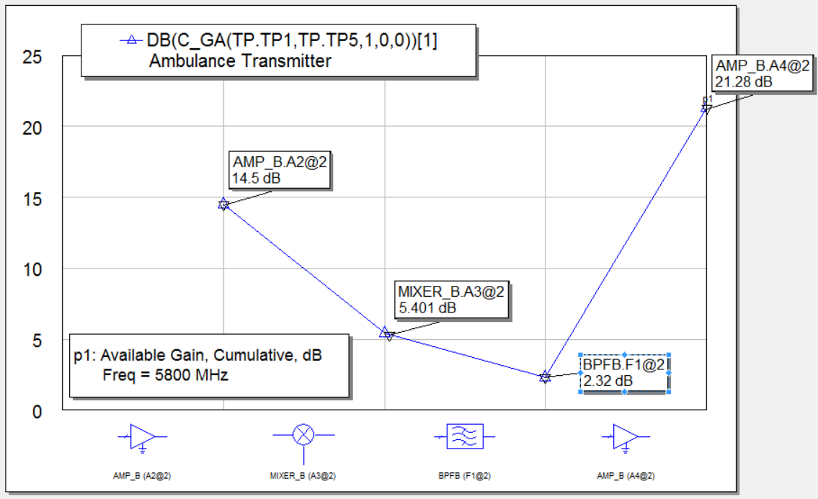
CASCADED GAIN

Slide 66
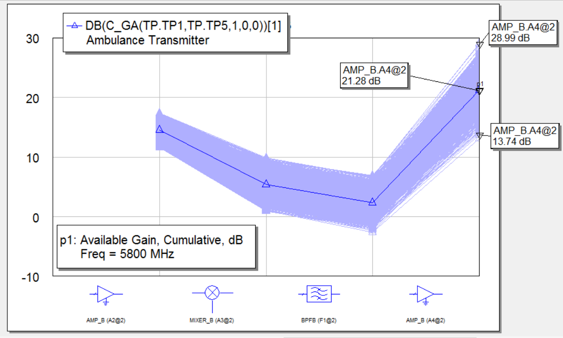
CASCADED GAIN - YIELD ANALYSIS
Cascaded Gain varies between 13.74dB to 28.99dB.

Slide 67
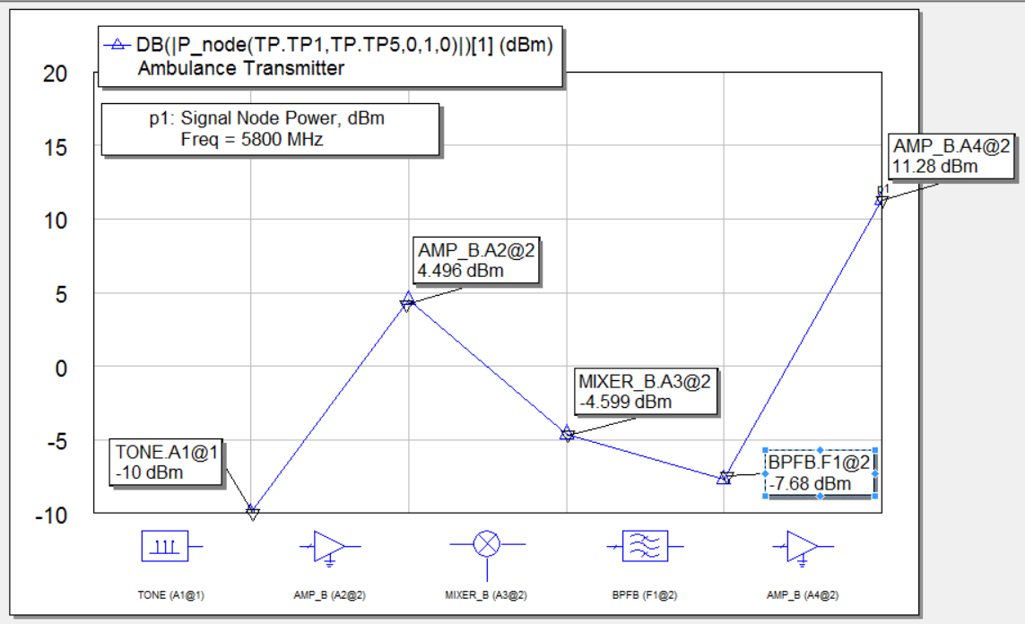
CASCADED NODE POWER
The cascaded Node Power of the Ambulance Transmitter is 39.73 dBm.

Slide 68
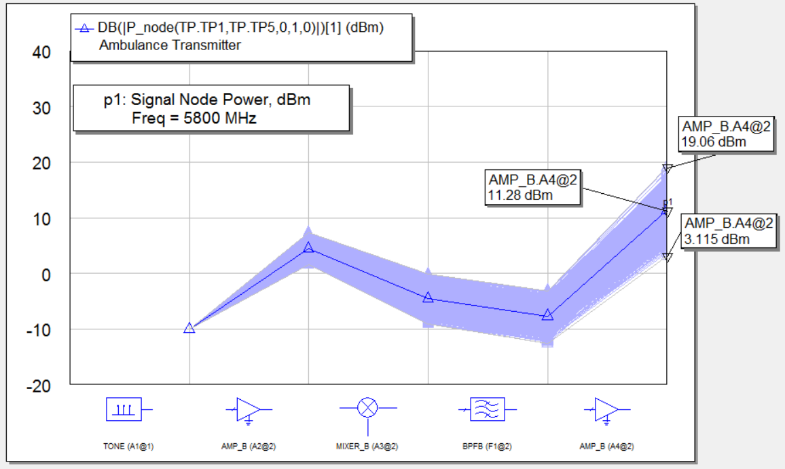
CASCADED NODE POWER - YIELD ANALYSIS
The cascaded node power fluctuates between 3.115dBm to 19.06dBm.

Slide 69
TX ANTENNA
PARAMETERS | VALUE
Model | AIR-ANT2422DB-R-OEM
Gain | 2.2 dBi
Radiation Pattern | Omnidirectional
Cost | $245

Slide 70
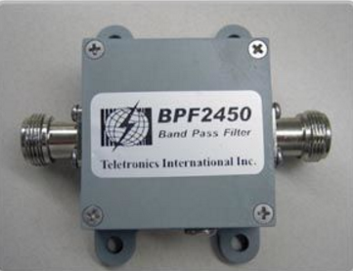
BANDPASS FILTER
PARAMETERS | VALUE
Manufacturer | Teletronics
Model | 17-202
Insertion Loss | 3 dB
Noise Figure | 0.5 dB
BW | 150 Mhz
Frequency | 5.8 GHz

Slide 71

LNA
PARAMETERS | VALUE
Model no. | HMC599ST89
Gain | 14.5 dB
Noise Figure | 2.2 dB
P1dB | 19 dBm
OIP3 | 39 dBm
Vdc | 5 V
Idc | 120 mA
Freq Range | 50 – 1000 MHz

Slide 72
MIXER
PARAMETER | VALUE
Model no. | HMC787A
Loss | 9 dB
NF | 9 dB
Freq range | 3 – 10 (GHz)
Drive Level | 17 dBm
P1dB | 17dBm
IIP3 | 24 dBm

Slide 73
POWER AMPLIFIER
PARAMETERS | VALUE
Model | HMC659LC5
Gain | 19 dB
Frequency Range | DC - 15 GHz
NF | 3 dB
OIP3 | 35 dBm
Vdc | 8V
Idc | 300mA

Slide 74
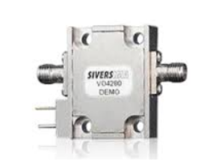
LOCAL OSCILLATOR
PARAMETERS | VALUE
Model | HMC431LP4
Frequency Range | 5.5 - 6.1 GHz
Output Power | 2 dBm
Supply Voltage | 3V
Supply Current | 27mA

Slide 75
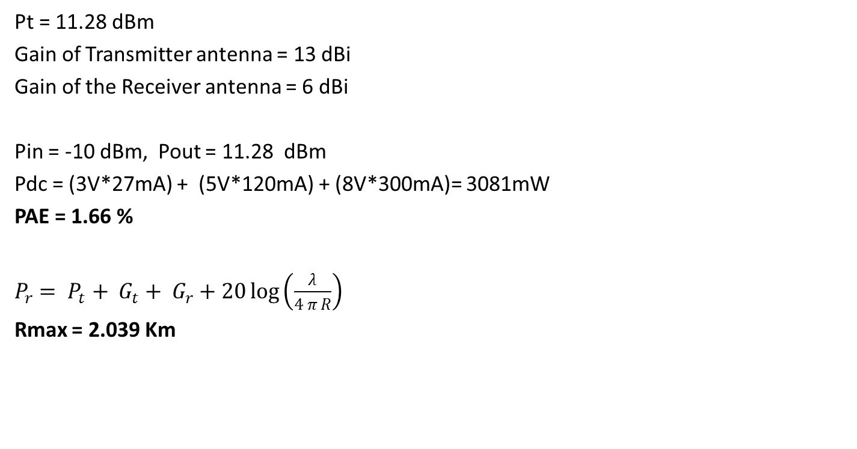
HAND CALCULATIONS
Pt = 11.28 dBm
Gain of Transmitter antenna = 13 dBi
Gain of the Receiver antenna = 6 dBi
Pin = -10 dBm, Pout = 11.28 dBm
Pdc = (3V*27mA) + (5V*120mA) + (8V*300mA)= 3081mW
PAE = 1.66 %
$P_{r}= P_{t}+ G_{t}+ G_{r}+20\log\left(\frac{λ}{4 π R}\right)$
Rmax = 2.039 Km

Slide 76
COMPLIANCE MATRIC FOR 5.8GHz CHANNEL
PROPERTIES | SPECIFICATION | PROJECTED PERFORMANCE | COMPLIANT
Operating Frequency (GHz) | 5.725 – 5.85 GHz fc = 5.8 GHz | 5.725 – 5.85 GHz fc = 5.8 GHz | YES
Transmitted Power ( max allowed ) | 24 dBm | 24.28 dBm | ALLOWABLE
Noise Figure (RX) | 12 dB | 1.912 dB | YES
Maximum Range | 5 Km | 2.039 Km | NO
Minimum Detectable Signal | -83 dBm | -83 dBm | YES
Maximum Antenna Gain (Rx dBi) | 7 dBi | 6 dBi | ALLOWABLE
Expected DC power (TX and Rx Drone ) | 2 W | 1.2W | YES

